Slide 1


How can homes can be heated with electricity sustainably?
Dr Richard Lowes
@UKERCHQ @heatpolicyrich
Notes:
If a change of photo is needed, go into the fill options in the format picture side panel when selected and select ‘insert picture from file’
This will ensure the shape and soft edges remain.

Slide 2

Why electricity?
UK has lots of gas and oil heating.
‘Electrifying’ heat seen as a key approach to decarbonise heating for over a decade.
Simple idea:
  Low carbon electricity e.g. from renewables turned into heat.
But, requires a lot of work.
Amazing cost reductions for renewable electricity are positive – but this will cost something.
Electricity is already becoming increasingly green.

Slide 3
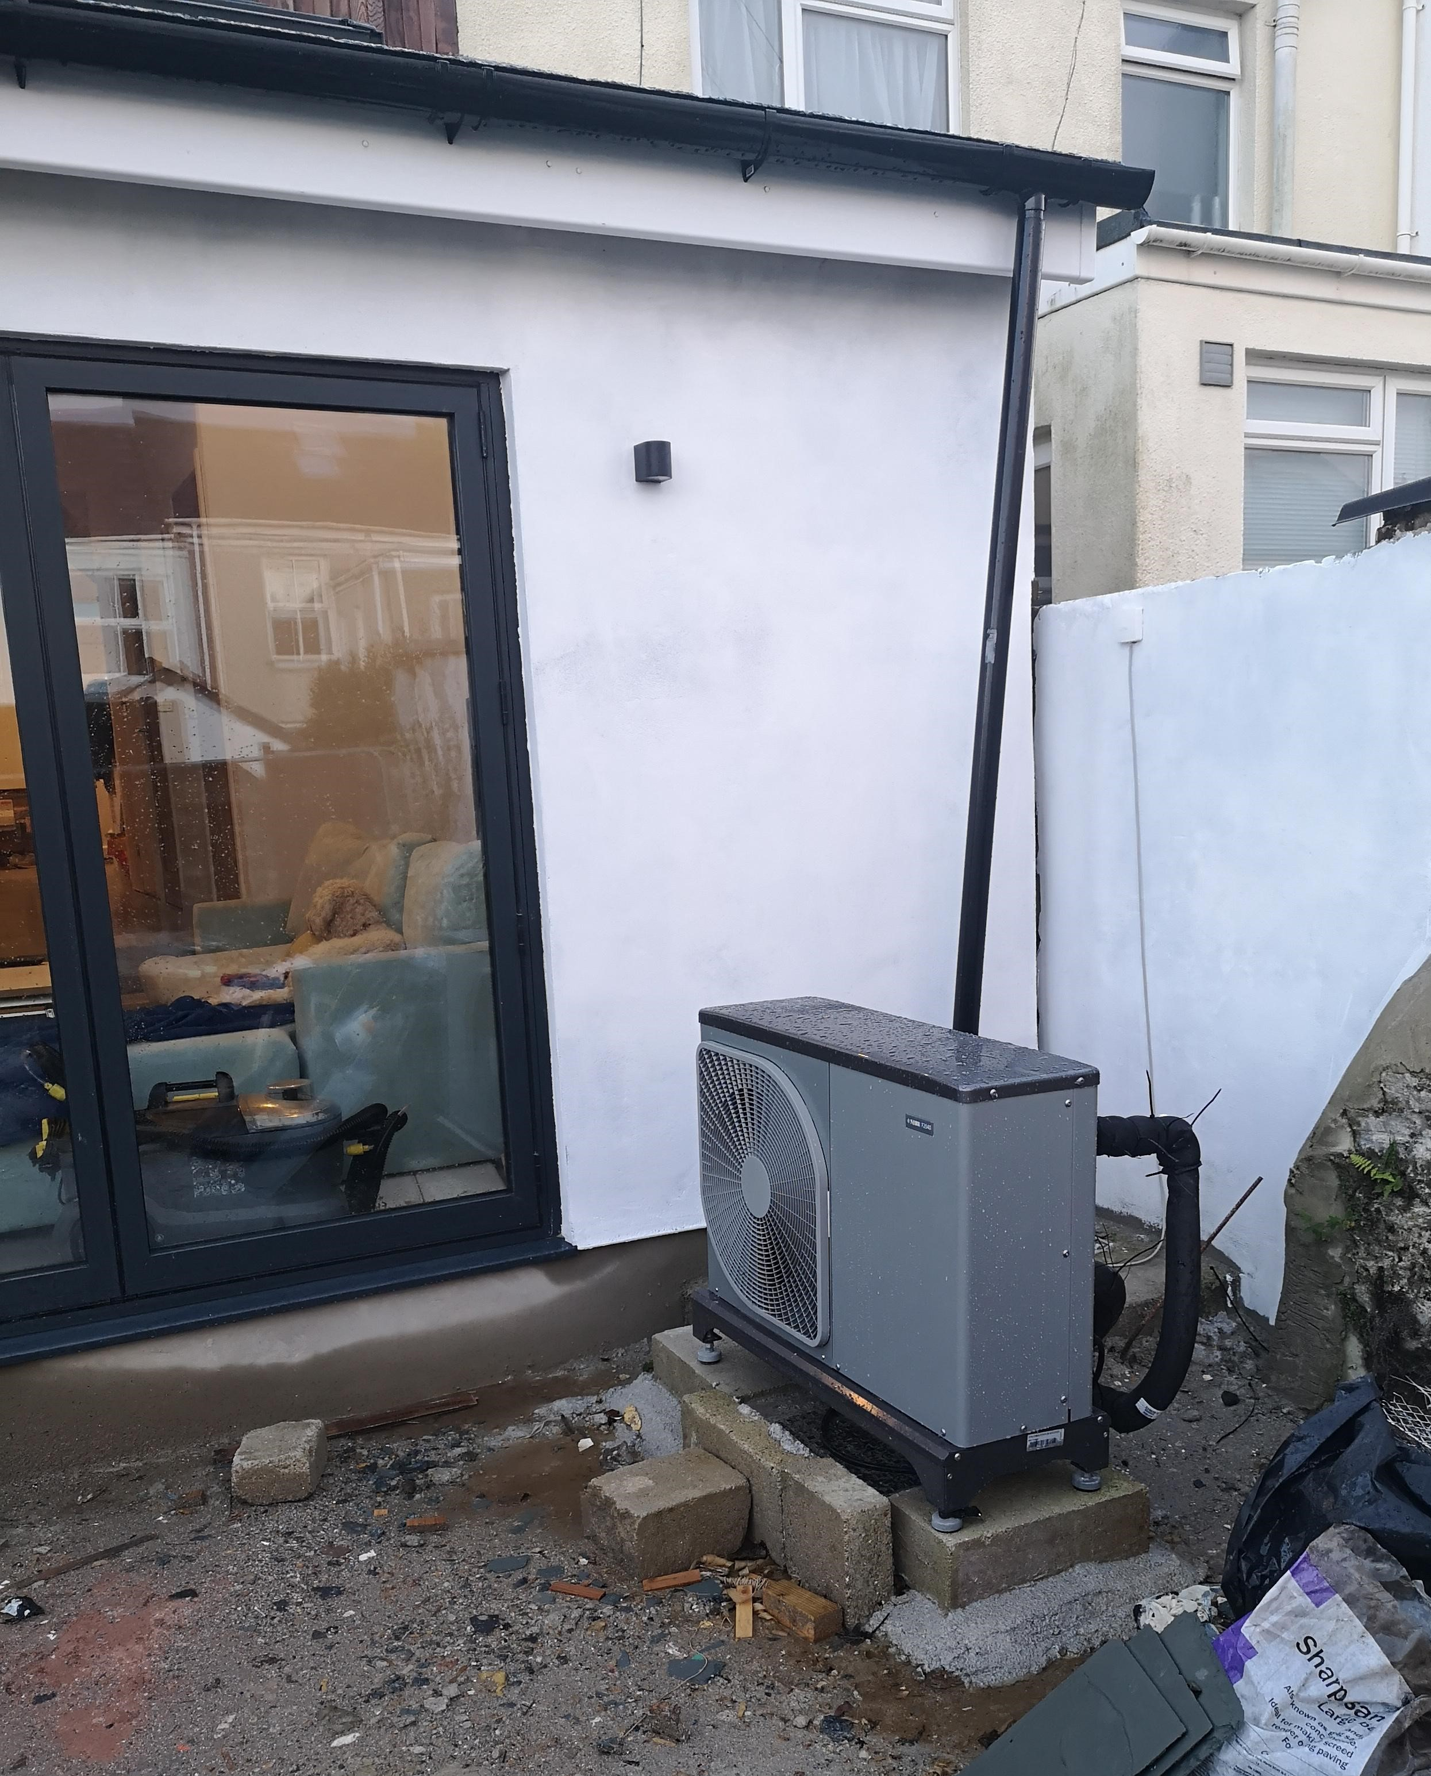
Heat pumps are a vital technology
Heat pumps extract heat from the environment:
  Ground, Air, Water
Can be powered by green electricity.
Produce much more heat than the electricity you put in.
Used globally at scale, very similar technology to fridges.
Work at lower temperatures than boilers:
  Require efficient buildings, possibly bigger
  radiators and a hot water cylinder.

Slide 4
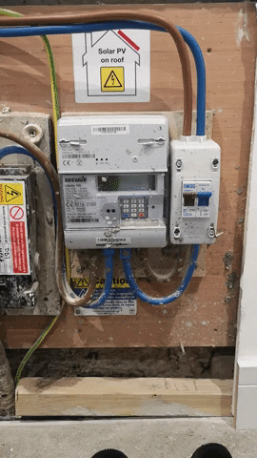
Other technologies may have a smaller role
Heat networks can use electricity and large heat pumps.
Modern storage heating.
Basic electric heaters in very efficient homes may make sense.
Smart metering and ‘time of use tariffs’ can reduce costs.

Slide 5
We can act on this now
Technologies exist – and we should deliver them.
Hard work is needed, alongside building upgrades:
  More electricity generation
  Bigger electricity networks
And we have to decide how to pay for this.
Overall many potential positives:
  Healthier, warmer homes
  Making the most of UK renewables
  Reduced imports
  Hi-tech focus.
Heat pumps sold per 1000 households in 2018

Slide 6

Existing interests have a lot to lose
Strong resistance from elements of the UK’s gas industry to electrification - through lobbying.
New entrants and ideas struggle.
Converting gas grid to hydrogen is being promoted as a ‘simple’ way to get to low carbon heating but:
  Is it possible? How much it will cost? It’s never been done before.
  It’s expected that it will be made from fossil gas with ‘carbon capture’.
Do trials, but I worry that we will waste time thinking about hydrogen when we already know what to do:
Focus on electrification.

