Slide 1
Community-led approaches to retrofit
Jonathan Atkinson

Slide 2
1. How we do retrofit at Carbon Co-op
Householder-owned and led with not-for-profit status
Greater Manchester-rooted (but partners around UK)
A social enterprise – trading for social & environmental good
A focus on fairness and energy justice
Notes:
We believe that Community-led, not for profit social enterprises are the best way to kick start a retrofit revolution
We employ 13 members of staff and turnover over half a million pounds a year
Not for profit doesn’t mean no profit – it means generating profit for a social or environmental purpose
A social enterprise means we can realise all the benefits of retrofit including warmer, greener homes but also well paid, skilled jobs for local firms

Slide 3
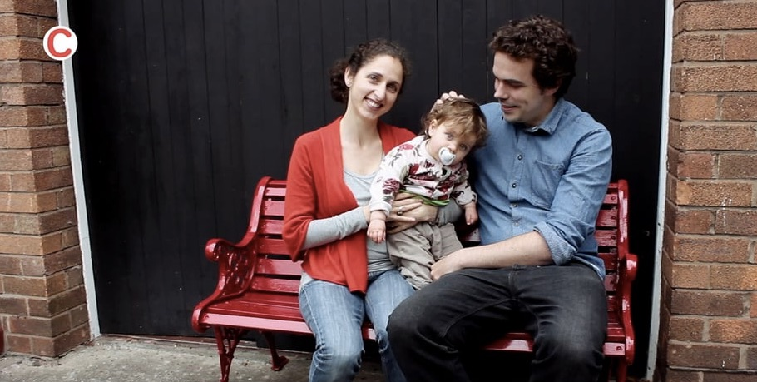
Notes:
Briefly – what is retrofit;
whole house,
comfort, cost and carbon

Slide 4
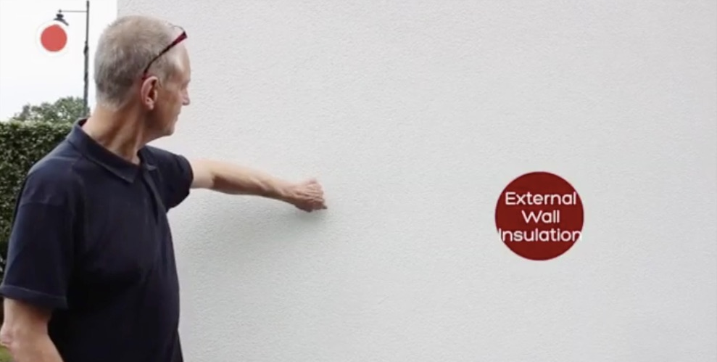

Slide 5
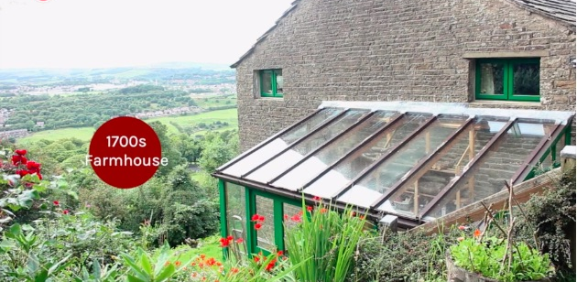

Slide 6
2. Why isn't retrofit happening?
The companies offering retrofit are not trusted
Householders can’t find builders with the right skills
It's not normal – no one you know has had a retrofit
People see examples of poor work and are put off

Slide 7
3. Retrofit policy in the UK is too ‘top down’
Every house is different but everyone is treated the same
The focus is only on money, not quality, comfort, & carbon
The large companies involved are not trusted
It has not worked!

Slide 8
4. Good ideas spread like a meme, from the ‘bottom up’
Successful ideas and approaches spread quickly, popping up in similar villages, towns and cities…
The co-operative movement
The school strike
Community Renewables

Slide 9
5. Who would you trust to refurbish your home?
A leaflet about a gov’t scheme or a Community Energy flyer?
A contractor based 200 miles away or a Local Firm firm?
A rep with a sales pitch or a friend or neighbour?

Slide 10
6. Benefits
Local and accountable
Trusted
Co-operative
Community-wide
...a competitive advantage (it’s what people want!)

Slide 11
7. Our Wish list
A community-led, nation-wide retrofit programme
A reformed ECO that works for hard to treat homes
Council issued zero interest loans for householders
Integration in to local energy markets
Retrofit apprenticeships funding for local firms
0% VAT on retrofit
An Ofgem definition of community-led
Notes:
- Local energy markets – the easiest KW of energy to decarbonise is the one you never generate.

Slide 12
Community-led approaches to retrofit
Jonathan Atkinson
Notes:
Summary: a top down approach to retrofit has failed, but investing in a community-led approach can kick start a retrofit revolution delivering warmer, greener homes and local jobs and benefit.

