Slide 1
What we buy
Mike Berners-Lee

Slide 2
Thank you!
for being in this Assembly

Slide 3
Average UK person’s Greenhouse Gas Footprint: 12.7 tonnes CO₂e per year

Slide 4
Average UK person’s Greenhouse Gas Footprint: 12.7 tonnes CO₂e per year
Everything else
23%
Food 25%
Travel
27%
Home + accommodation
25%

Slide 5
Physical things we buy (other than food)
Everything else
23%
Food 25%
Travel
27%
Home + accommodation
25%

Slide 6
The carbon footprint of things we buy
Manufacture
+
Use
+
End of life

Slide 7
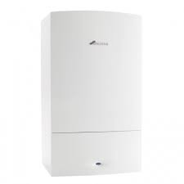
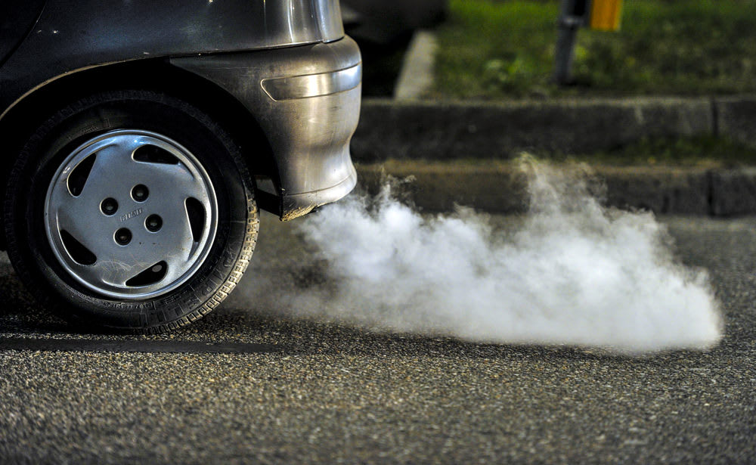
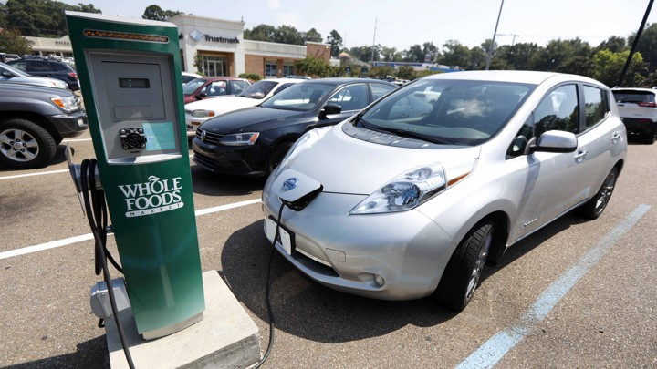
Gas Boiler
Petrol car
Electric car
+
Use
+
Manufacture
End of life
Efficiency is critical.
+
Use
+
Manufacture
End of life
+
Use
+
Manufacture
End of life
Efficiency is and electrification is critical but manufacture also has a big impact

Slide 8
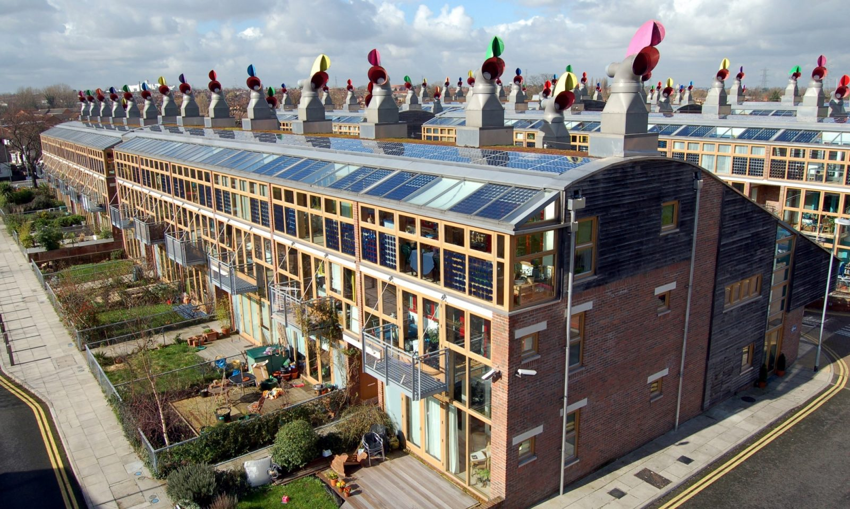
Smartphones
Furniture
Houses
+
+
Manufacture
Use
End of life
IT kit needs to last and be repairable.
+
End of life
Manufacture
Make to last, sustainable materials, repair and pass it on.
+
Construction ?
Living in the house depends on how it was built
Build zero energy homes or better and improve old ones

Slide 9
Some core materials – and ways to cut carbon
Steel
Use less
More recycling
Phase out coal from production
Cement
Alternative materials – e.g. timber frame houses.
‘Eco cement’
Plastic
Carbon is not the only problem
E.g. Glass bottles could be higher carbon but better in other ways
Recycle
Wood
Trees remove carbon from the air
Must be from sustainable forestry
Batteries
Huge issue for electric cars and also for IT
Not just carbon

Slide 10
5 Rs - for products and packaging
Reduce
Buy less junk
Buy ‘pre-loved’
Choose sustainable materials and sustainable production
Buy quality things that are made to last.
Share, borrow or hire
Repair (and maintain)
Re-use
Or pass it on to someone who will reuse it
Make it into something new
Recycle
E.g. It takes about 20% of the carbon to recycle steel as to create it from iron ore
Segregate everything
Recover (almost last resort)
E.g. burn it to get some energy back

Slide 11
Everything else
23%
Food 25%
Travel
27%
Home + accommodation
25%

