Slide 1
Bioenergy role in electricity production and sustainability issues Prof. Patricia Thornley Director, Energy and Bioproducts Research Institute and Supergen Bioenergy Hub 18 April 2020

Slide 2
Electricity from biomass 2018

Slide 3
Trends in biomass electricity
Electricity generation increased 9.4% from 2018
Small-scale: 58 new small self-supplying sites in 2018
Large-scale: Two coal-fired power plant conversions:
Lynemouth converted to wood (420 MW); Drax additional plant biomass capacity (700 MW)
Energy from waste up 5.5%
Continued fall of landfill gas (8.6%)

Slide 4
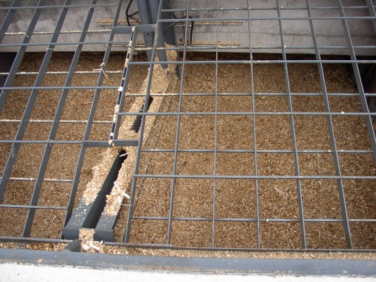
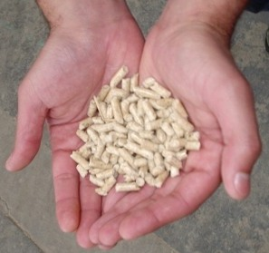
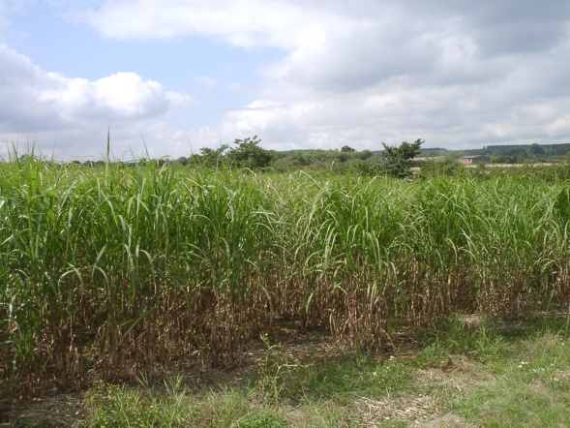
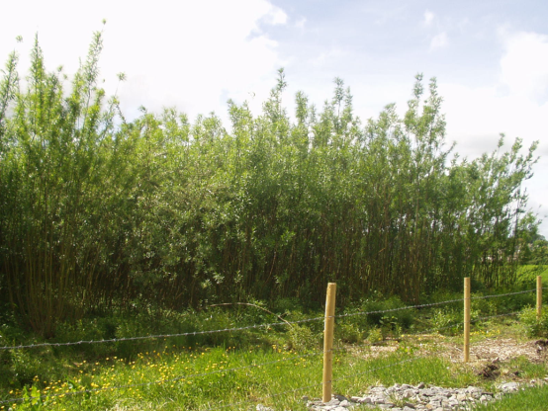
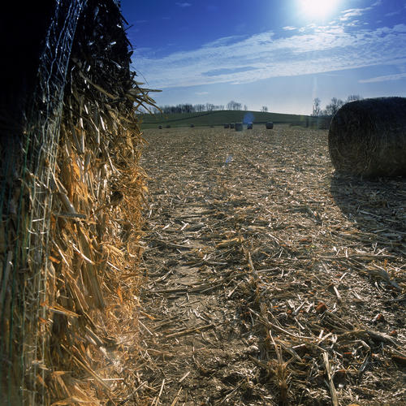
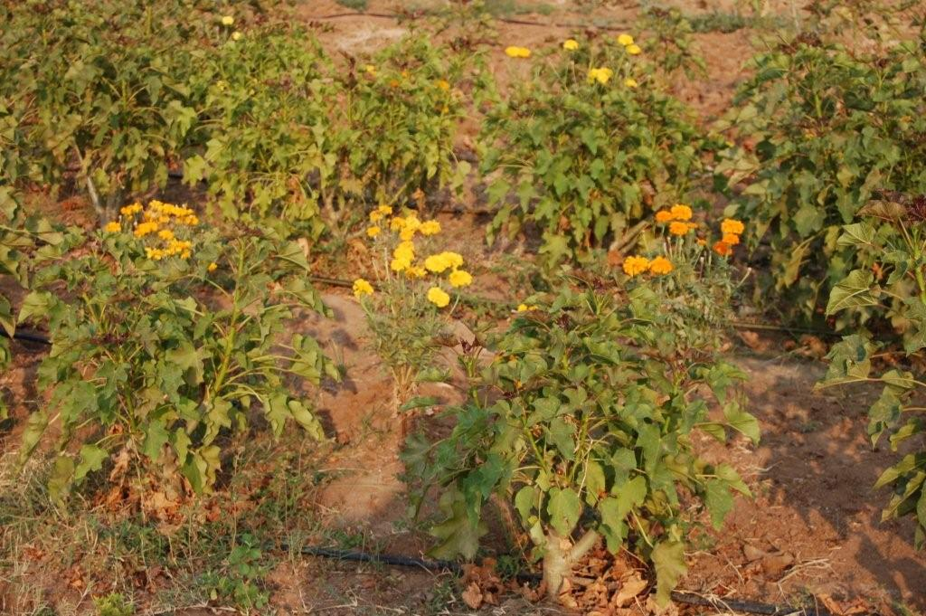
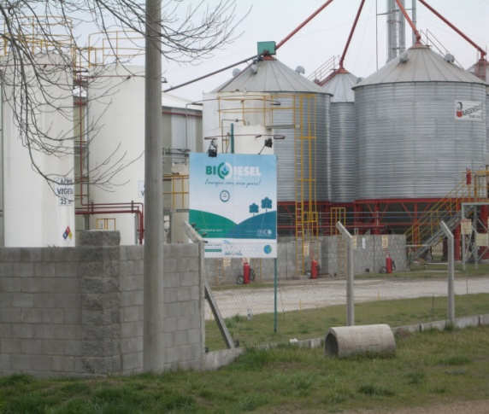
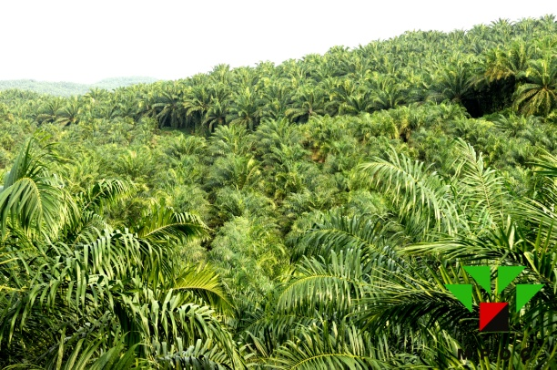
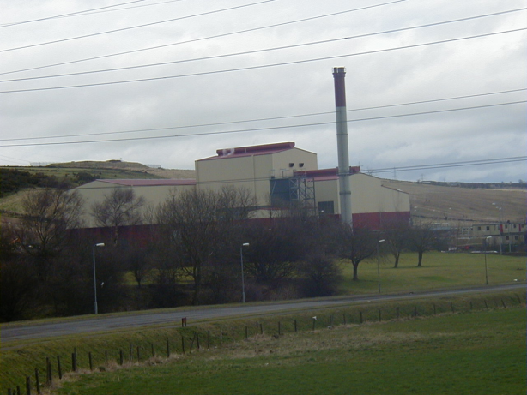
Where bioenergy comes from

Slide 5
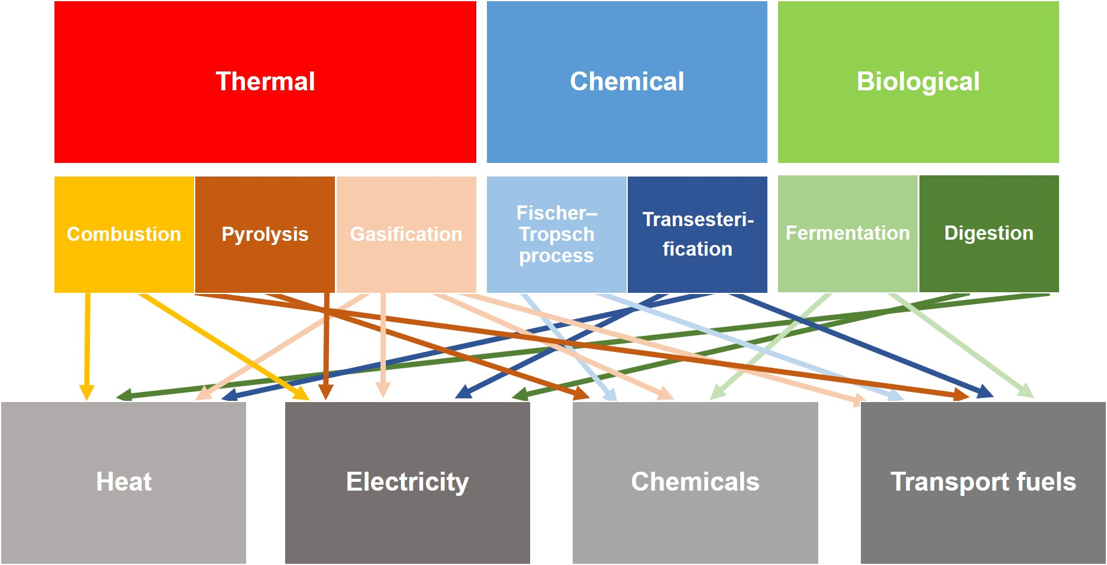
What bioenergy is used for
Thornley, P., “Biofuels Review”, Report for Government Office for Science, prepared as part of the Foresight Programme, June 2012

Slide 6
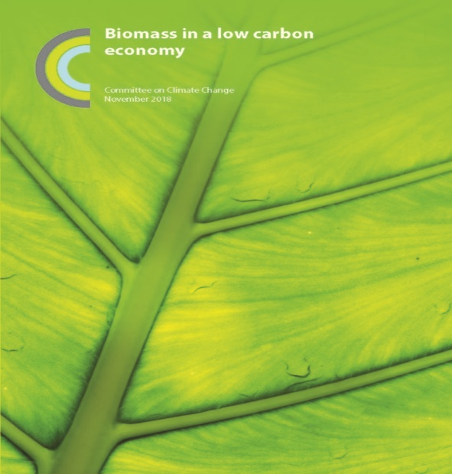
Biomass in a low carbon economy
“Biomass can be produced and used in ways that are both low carbon and sustainable”
“Biomass can make a significant contribution to tackling climate change”
“There are risks that biomass production and use could in some circumstances be worse for the climate than using fossil fuels”

Slide 7
Possible future role for biomass
Up to 45% of UK energy demand¹
10% electricity (baseload)
50% heat (industrial, district, gas)
20% liquid fuels (aviation, shipping, heavy duty/mobile plant)
1. Welfle A., Gilbert P., Thornley P., Securing a bioenergy future without imports, Energy Policy, vol 68, 2014

Slide 8
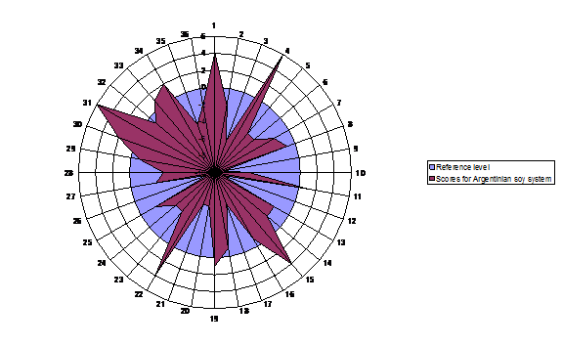
Sustainability trade-offs
Fossil fuel impacts
Biodiesel impacts
Thornley & Gilbert, “Biofuels: Balancing risks and rewards”, Interface Focus, 2013

Slide 9
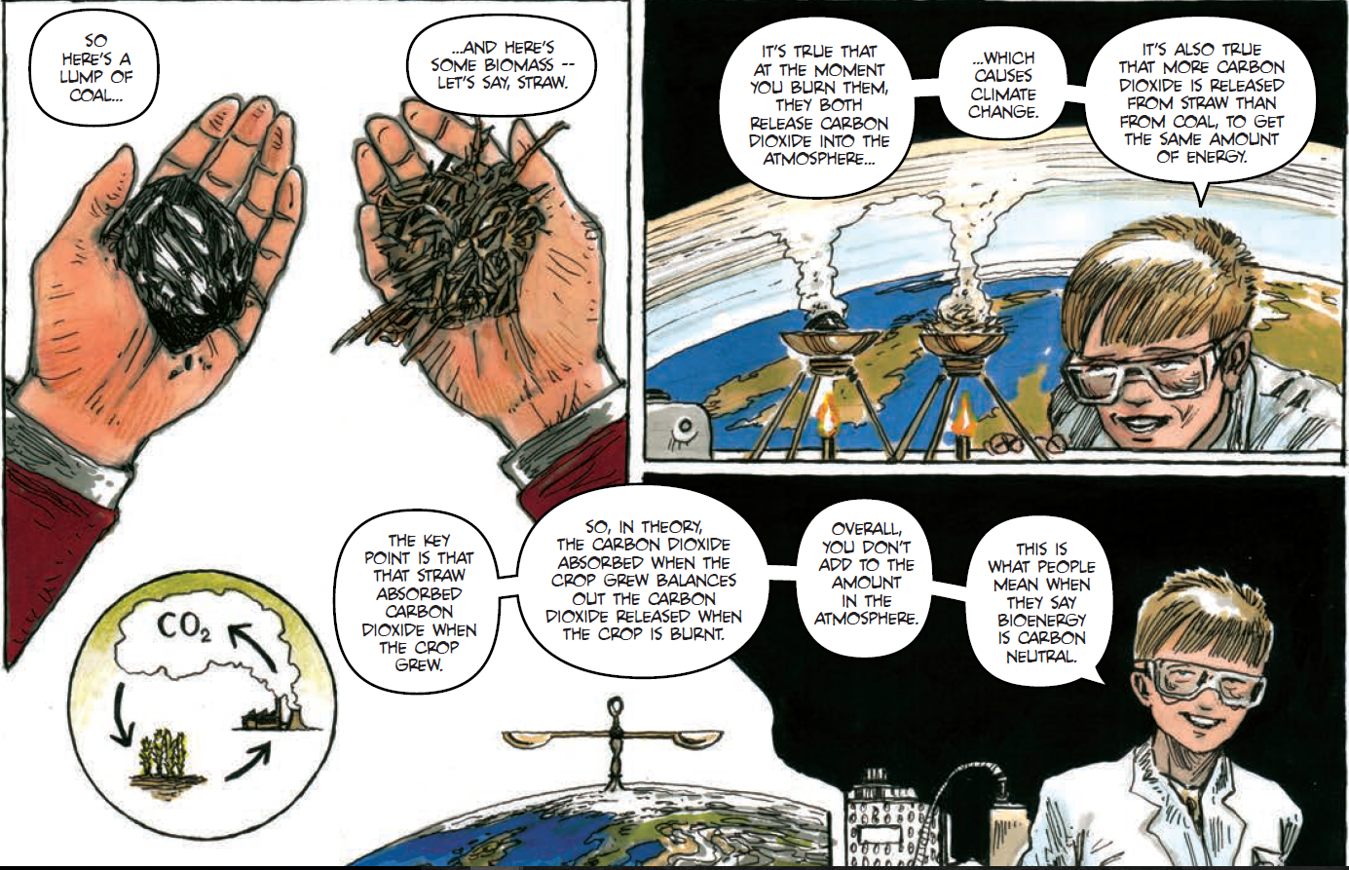
Carbon balances
Bioenergy:
A graphic introduction
Supergen Bioenergy Hub
supergen-bioenergy.net/comic

Slide 10
Patricia Thornley p.thornley@aston.ac.uk www.supergen-bioenergy.net A graphic introduction to bioenergy: www.supergen-bioenergy.net/comic

